Slide 1

VISUALIZING The Storm Data
Nivedita Vattipalli (UH ID: 1619486)
Ravali Basna (UH ID: 1596519)
Rohitha Muppidi (UH ID: 1626066)

Slide 2
Topics
Problem Definition
Implementation
Results(Expected)
Conclusion and Future work

Slide 3
Problem Definition
Everyone deals with storms at some point or another. So, some expanded knowledge about them is always a benefit.
Although storms cannot be prevented, being storm ready can help communities minimize their loses.
Our project fetches the exploratory data from Storm Events Database published by National Weather Service(NWS) and analyses the damage occurred and precautions to be taken based on the intensity and frequency of storms.
We are showing the obtained results in the form of various graphs and techniques like donut pie chart, heat map, bar graph etc.,

Slide 4
Implementation
Dataset Attributes
State
Year
Event Type
Injuries Direct and Indirect
Deaths Direct and Indirect
Damage to Property and Crops
Flood Cause
Tornado F-Scale
Fatality Type

Slide 5
Implementation
Data pre-processing
We have written SQL queries in Microsoft Excel to group the data based on the tornado intensity and storm type.
Modified the data related to Damages by replacing K with 1000 and M with 1,000,000 which represents the amount of damage.
There are few states with TOR_F_SCALE value as EFU which is invalid. So, depending upon the damages and other factors, updated the intensity value accordingly.

Slide 6
Graphs generated
Heat Map
Here we have visualized the number of storms versus each state to understand which state is hit by more number of storms.
We used heat map such that the state which is hit by more number of storm is represented by a colour having higher intensity.

Slide 7
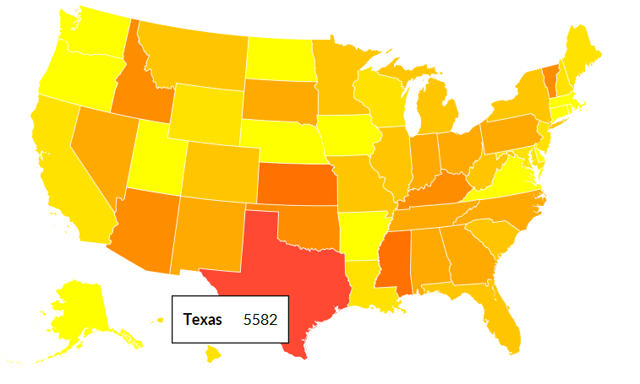
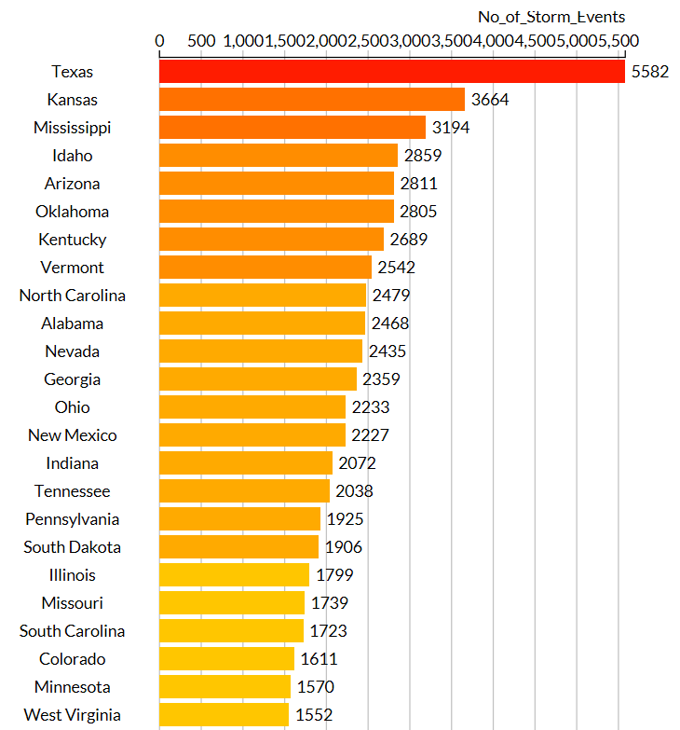
Generated heat map

Slide 8
Graphs generated
Donut Pie Chart
Use case: As a National Weather Service forecast officer, one would like to know the areas which are severely affected by the EF4 and EF5 tornadoes such that more precautionary measures can be taken in those areas to avoid damages to people and property.
Here we have visualized the states which are mostly affected by tornadoes based on the F-Scale Intensity.
Our graph shows the top 5 states for each F-Scale intensity for the storm data collected from 2011 to 2017.

Slide 9
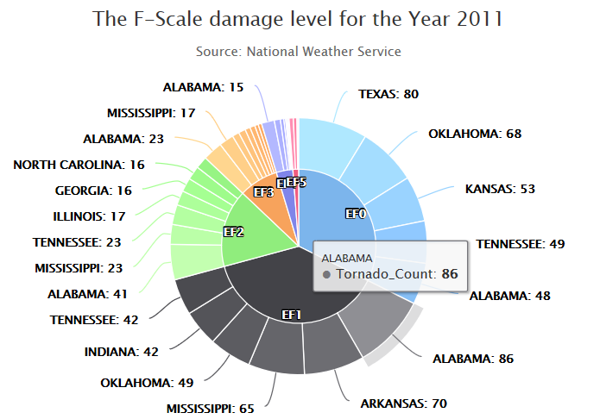
Generated donut pie chart
Similar chart is generated for the storm data from years 2012 to 2017

Slide 10
Graphs generated
Bar Chart and Pie Chart
Use case: The assessment of damage level based on the deaths and damage levels helps the Government and the public to take necessary precautions to protect and save themselves from the upcoming storms.
Here we have visualized the total number of deaths caused from 2011 to 2017 for different levels of tornado severity and the total number of deaths happened in each year for different tornado intensities.
BAR CHART shows the total number of deaths caused from 2011 to 2017 for different levels of tornado severity.
PIE CHART shows the total number of deaths happened in each year for different tornado intensities.

Slide 11
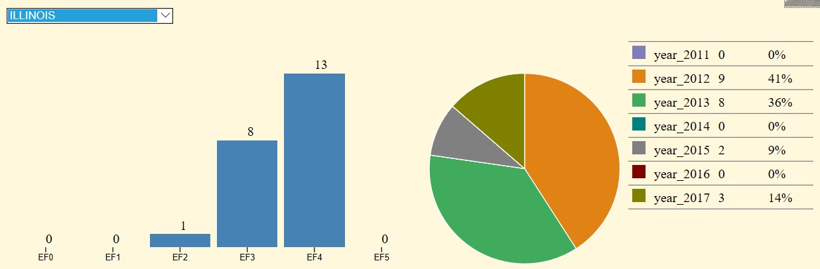
GENERATED BAR CHART and PIE CHART

Slide 12
Graphs generated
Interactive Bar Chart
Use case: To help the weather service forecast officer in identifying states which are to be taken appropriate precautionary measures based on the number of damages caused by the storm.
Here we have visualized the damages to the property incurred in dollars by the weather event in each state for different event types from 2011 to 2017
The Values in X-axis represents different states in US and the Values in Y axis represents the damages incurred in dollars for different event types.

Slide 13
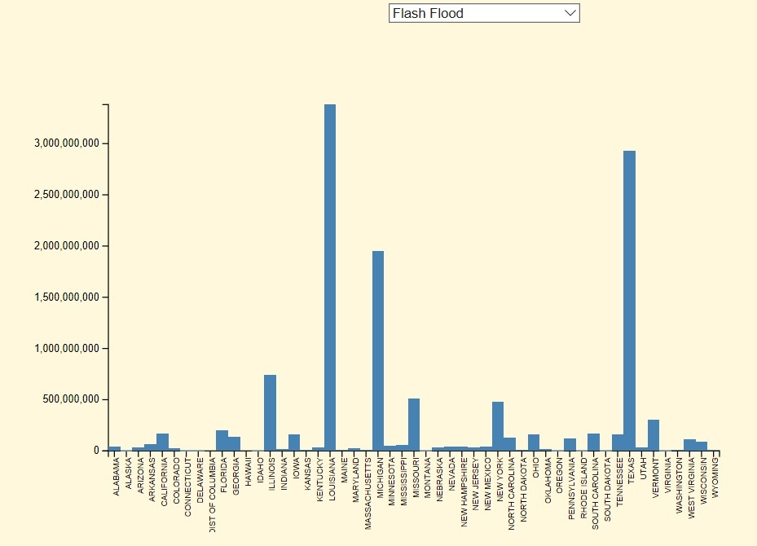
GENERATED INTERACTIVE BAR CHART

Slide 14
Graphs generated
Interactive Bar Chart and heat map
Use case: To help the weather service forecast officer in identifying states which are to be taken appropriate precautionary measures based on the reason for occurrence of storm.
These interactive charts help in finding out the total number of storms in a particular state, different storms that occurred and the major reason for the occurrence of storms in that state.

Slide 15
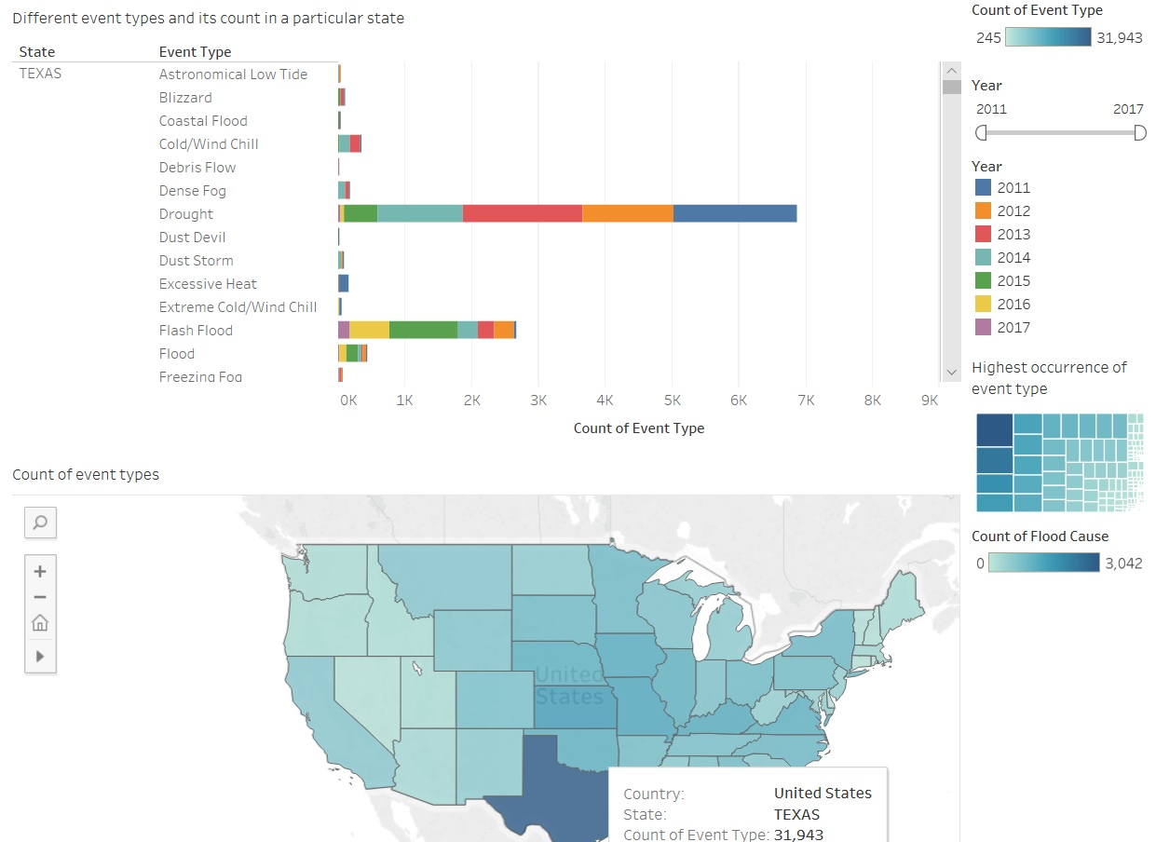
GENERATED INTERACTIVE CHART

Slide 16
Graphs generated
Bar Chart
Created a bar chart with States, Event Type and Year data which shows the different storms that occurred in each state of US from year 2011 to 2017.
This graph lets the user select the data corresponding to each year to visualize the data in specific and know the places which are affected by a particular type of storm more often.

Slide 17
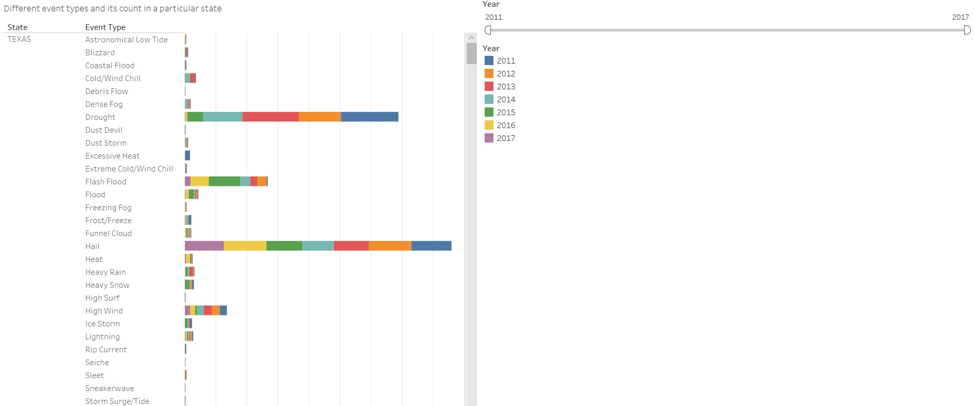
Generated graph using tableau

Slide 18
Work
Nivedita: Data Cleansing, Data Pre-processing, Data Analysis and Attributes Identification, Donut pie chart generation for the F-Scale damage level of top 5 states using java script code implementation, Bar Chart and Pie Chart generation using D3.Js to know all the States where there are deaths directly or indirectly related to weather event so that necessary precautionary measures can be taken, created a chart in Tableau which tells the most common reason for the occurrence of storms in a particular state, created web pages and integrated all the visualization techniques that are implemented.
Ravali: Data collection, Data Cleansing and grouping, Heat map generation for the intensity of storms using D3.Js, Created interactive bar chart which represents all the states in US and the damages incurred in dollars for different event types which helps the weather service forecast officer to identify states which are to be taken appropriate precautionary measures, created a bar chart which tells different event types and its count in a particular state for a specific year and its representation in US states map.
Rohitha: Data Cleanisng, Data Pre-processing, Correlation of States with event types and occurrence of storms using Tableau to know the places which are effected by a particular type of storm more often.

Slide 19
references
National Centers for Environmental Information [US] - https://www.ncdc.noaa.gov/stormevents/
https://d3js.org/
http://www.highcharts.com/
https://public.tableau.com/s/

